Slide 1

Hospital Management System
Designed by: Durgesh Kumar
Rahul Rajput
Harsh Raj
Summited to: Prof. Siddharth Jain

Slide 2
Index
Introduction
Objective
Methodology
Design & Implementation
Improvement
Remark

Slide 3
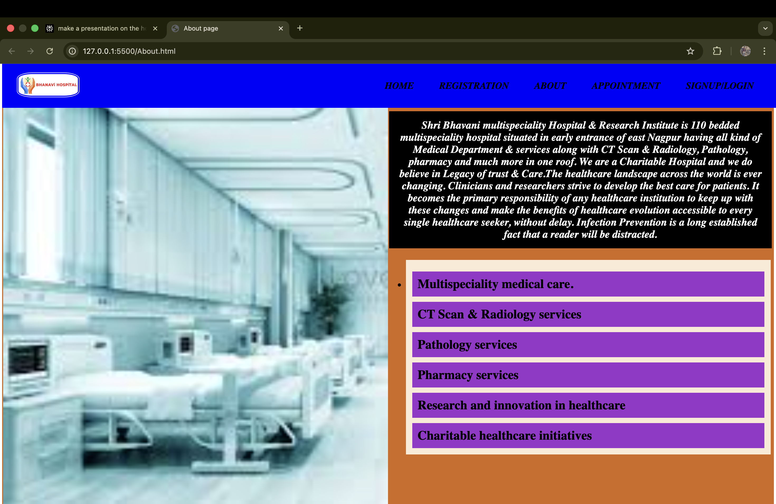
Introduction
Digital platform for managing hospital operations.
Integrates patient, doctor, billing, and laboratory data.
Improves overall efficiency and patient care quality.

Slide 4
Objective
Automate and streamline key hospital processes.
Enable real-time information access.
Enhance communication between staff, patients, and administrators.
Reduce manual errors in diagnosis and billing.
Drive better efficiency and service.

Slide 5

Methodology
Analyze workflow and user needs.
Design system architecture and interface.
Develop management modules (patient, staff,
billing, lab).
Test: unit, integration, user acceptance.
Deploy, train staff, and provide ongoing support.

Slide 6
Design & Implementation
Architecture: Centralized database and modular system.
Key Modules:
Patient and Staff Management.
Billing and Payments.
Laboratory & Pharmacy Management.
Reporting & Analytics.
Technology: HTML and CSS.

Slide 7
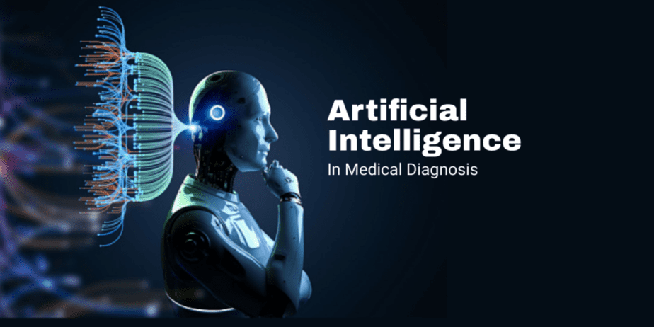
Improvement
AI-driven diagnosis and treatment suggestions.
Wearable device integration for real-time
monitoring.
Telemedicine and remote consultations.
Enhanced security: blockchain, biometrics.
Automated reminders for patients.

Slide 8
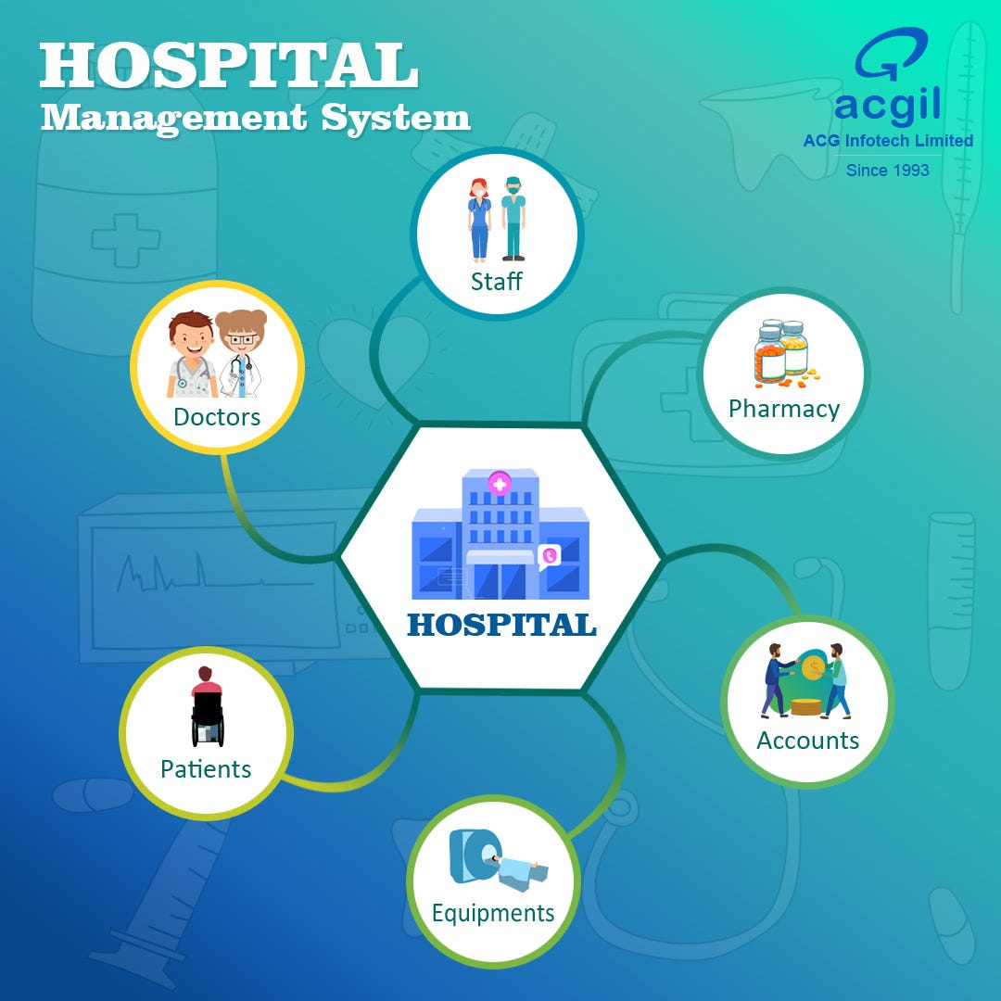
Remak
HMS is essential for modern hospitals.
Reduces cost and human error.
Enhances overall efficiency and patient
satisfaction.
Adopts and evolves with new medical
technologies.

